Slide 1
Vector Quantized Variational AutoEncoder (VQ-VAE)
Peng Jialun 2019.06.26

Slide 2


Slide 3
Generative Model
Two types
Implicit generative models: GAN
Likelihood based models: VAE, FLOW, Autoregressive models (PixelRNN/PixelCNN)

Slide 4
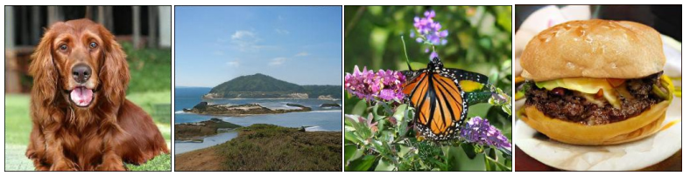
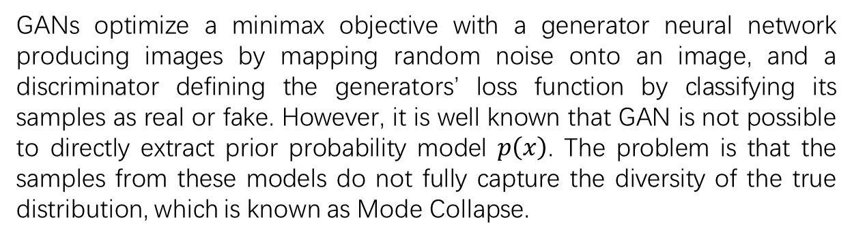
GAN
GANs optimize a minimax objective with a generator neural network producing images by mapping random noise onto an image, and a discriminator defining the generators’ loss function by classifying its samples as real or fake. However, it is well known that GAN is not possible to directly extract prior probability model $p\left(x\right)$. The problem is that the samples from these models do not fully capture the diversity of the true distribution, which is known as Mode Collapse.
Class-conditional samples from BigGAN

Slide 5
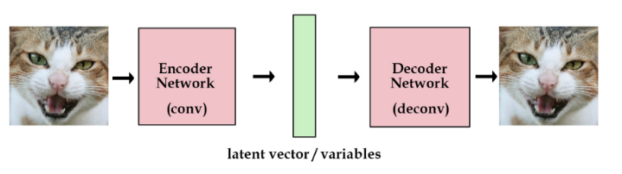
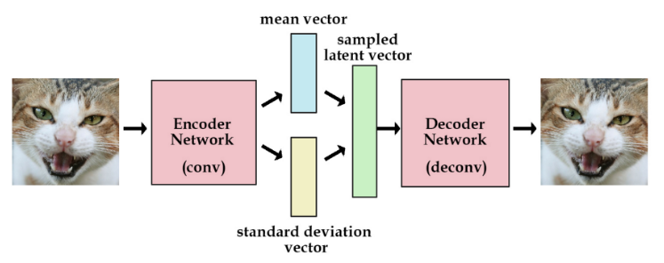
VAE
AutoEncoder
Variational AutoEncoder
Notes:
单位高斯分布

Slide 6
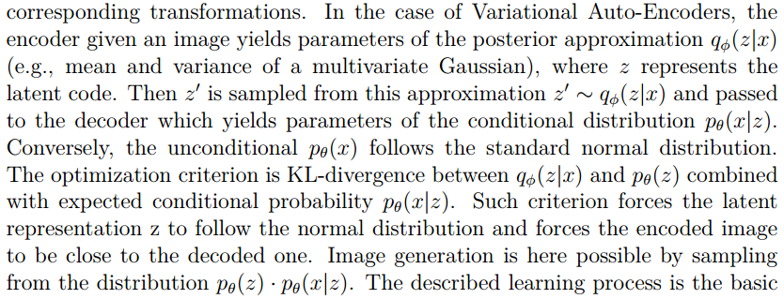
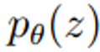
VAE
Notes:
近似估计数据分布的似然

Slide 7
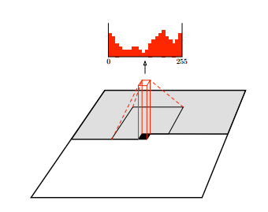
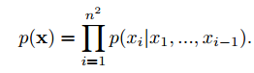
PixelCNN
PixelCNNs (and PixelRNNs) model the joint distribution of pixels over an image x as the product of conditional distribution. Every pixel therefore depends on all the pixels above and to the left of it. In PixelCNN every conditional distribution is modelled by a convolutional neural network. The use of convolutions allows the predictions for all the pixels to be made in parallel during training. During sampling the predictions are sequential .
Notes:
精确计算数据分布的似然

Slide 8
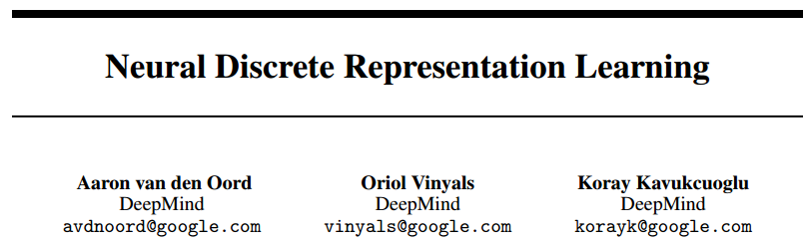
VQ-VAE
NIPS, 2017
Vector Quantized Variational AutoEncoder (VQ-VAE), differs from VAEs in two key ways: the encoder network outputs discrete, rather than continuous, codes; and the prior is learnt rather than static.
Notes:
基于向量量化的压缩。梯度在量化处不能前传，直接把Zq的梯度传给Ze

Slide 9
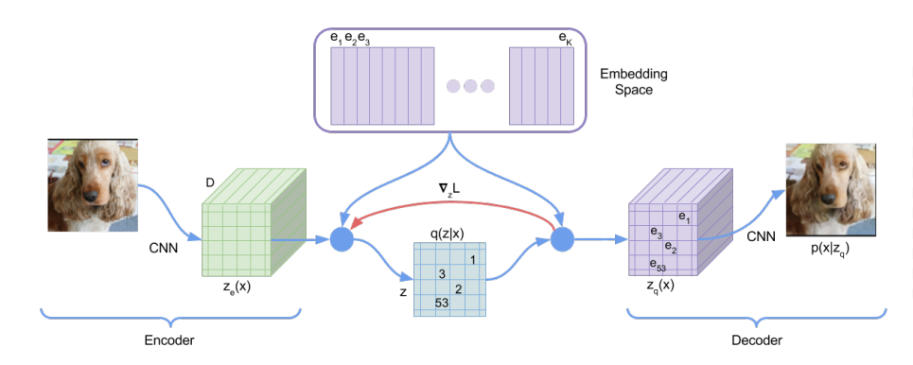
VQ-VAE
K=512
codebook
128×128×3
32×32×256
32×32×1
32×32×256
128×128×3
MSE loss
codebook loss
commitment loss
Notes:
基于向量量化的压缩。梯度在量化处不能前传，直接把Zq的梯度传给Ze

Slide 10
VQ-VAE
MSE loss
codebook loss
commitment loss
The MSE loss is the reconstruction loss which optimizes the decoder and the encoder.
The codebook loss，which only applies to the codebook variables, brings the selected codebook e close to the output of the encoder.
The commitment loss, which only applies to the encoder weights, encourages the output of the encoder to stay close to the chosen codebook vector to prevent it from fluctuating too frequently from one code vector to another.

Slide 11
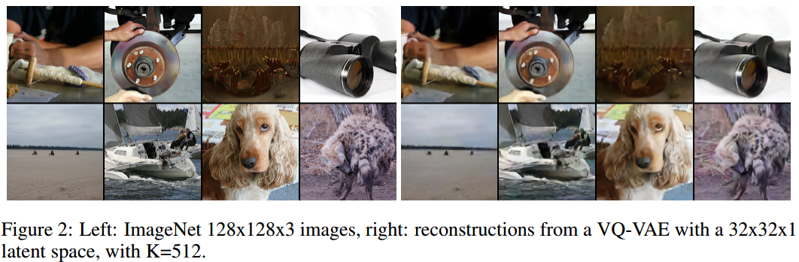
VQ-VAE
VQ-VAE can make effective use of the latent space, it can successfully model important features that usually span many dimensions in data as opposed to focusing or spending capacity on noise and imperceptible details which are often local.

Slide 12
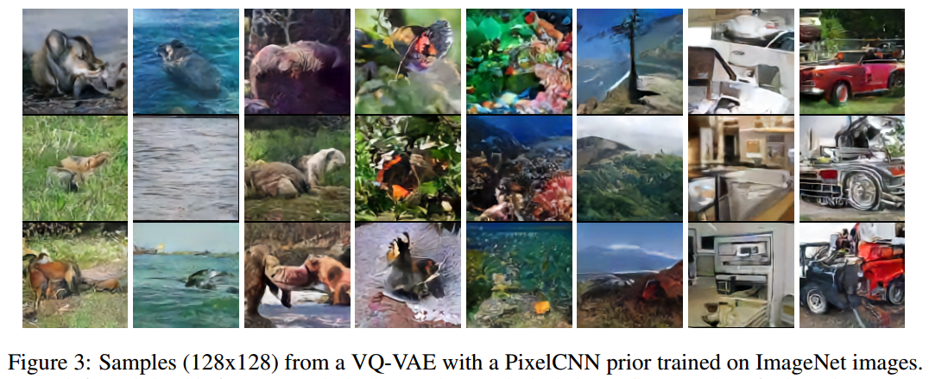
VQ-VAE
After training, we fit an autoregressive distribution over z. We use a PixelCNN over the discrete latents for images. Samples drawn from the PixelCNN were mapped to pixel-space with the decoder of the VQ-VAE and can be seen in Figure 3. Sampling in the compressed latent space is much faster than sampling in the pixel space. Any interest in audio or video generation, please refer to the paper.

Slide 13
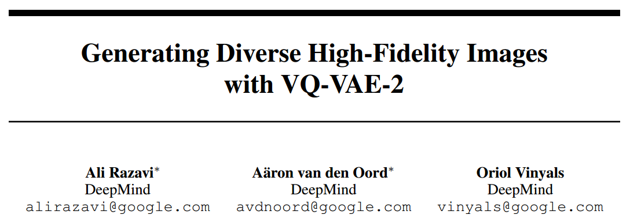
VQ-VAE-2
A multi-scale hierarchical organization of VQ-VAE, augmented with powerful priors over the latent codes.

Slide 14
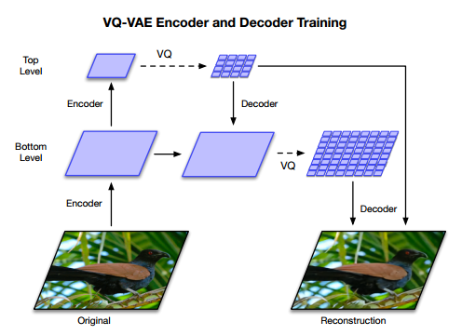
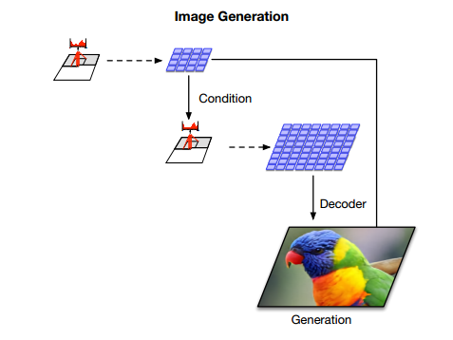
VQ-VAE-2
32×32×128
32×32×128
64×64×128
64×64×128
256×256×3
256×256×3
PixelSNAIL
32×32×128
Conditional PixelCNN
64×64×128
256×256×3

Slide 15
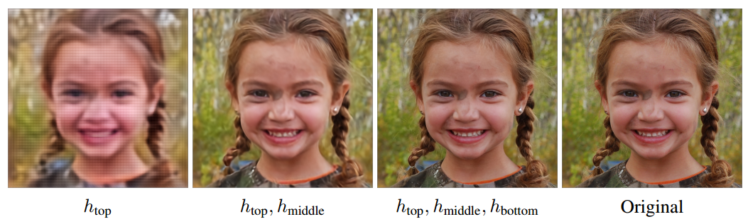
VQ-VAE-2
The main motivation behind this is to model local information, such as texture, separately from global information such as shape and geometry of objects. Our multi-scale hierarchical encoder has a top latent code which models global information, and a bottom latent code, conditioned on the top latent, responsible for representing local details. It encourages encoding complementary information in each latent map that can contribute to reducing the reconstruction error in the decoder.
FFHQ Reconstructions with three latent maps (top, middle, bottom).

Slide 16
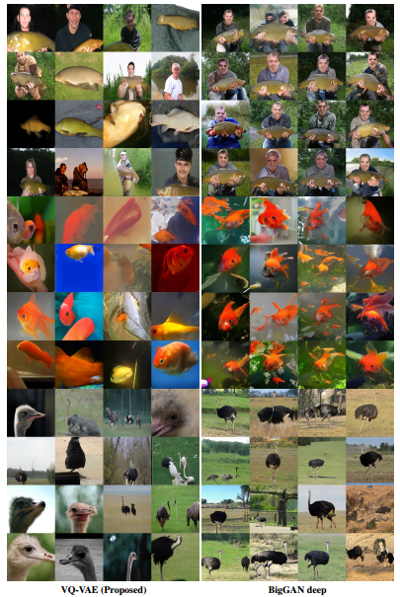
VQ-VAE-2
Notes:
ImageNet多样性更好

Slide 17
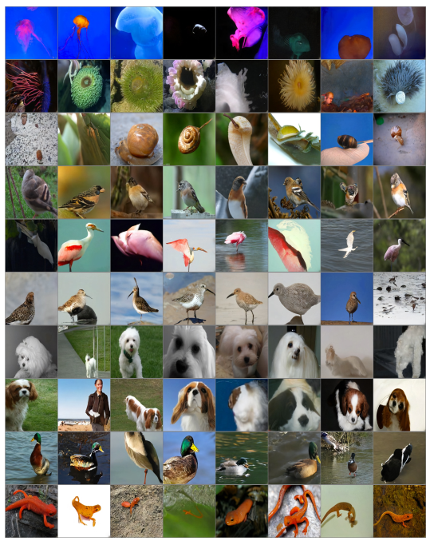
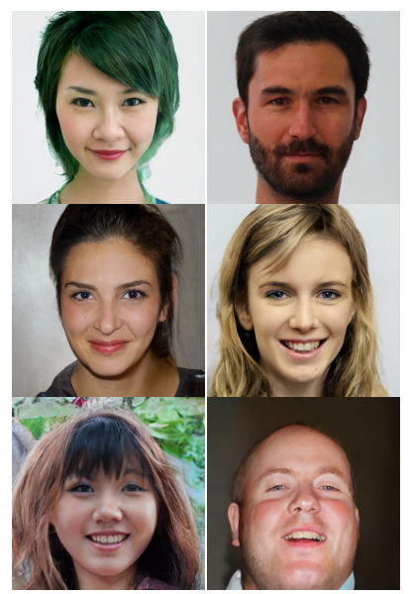
VQ-VAE-2
Notes:
人脸的对称性，头发整体颜色，双眼颜色相同

